Slide 1
Construction High Risk Strategy
2021 to 2023
October 2022
Notes:
Hello everyone,
Started in Construction → Complex and different → High Risk
Stand Up (if you answer yes, sit)
Have never been inspected by WorkSafeBC?
Have not been inspected in the last year?
Have not been inspected this year?
Risk Management Basics
Construction High Risk Strategy Overview
High Voltage Focus
What Does Proximity Look Like
The Hierarchy and the 30M33
Plan for Ten
42,000 employers and 160,000 workers!
Strategies originated in 2015…

Slide 2
KEY THEMES
Risk and risk assessments
Planning
Hierarchy of controls
*Action → Cross your arms (Seriously)
Notes:
The 2018 to 2020 Construction High Risk Strategy (CHRS) was developed due to address the following problem areas in the construction industry:
Inadequate planning and oversight by Prime Contractors on multi-employer worksites
Inadequate process or system in place for managing health and safety on multi-employer worksites by Prime Contractors
Inadequate supervision
Falls from elevation and struck-by mechanism of injury continuing to drive the serious injury rate
Contact with electricity continues to result in serious workplace injuries and death and has the potential for multiple worker serious injuries and fatals in a single incident

Slide 3
Back to the Basics

Slide 4
Risk Management Basics
1
2
Begin with the end in mind and seek first to understand.
Identify employer gaps in managing risks
Ask probing questions to understand employer knowledge and capability
Assess what information the employer needs to know based on their gaps
3
Communicate appropriate information on managing risks to employers, and enforce where necessary
Identifying hazards
Assessing and controlling risks
Health and safety programs
JOHSCs
Notes:
The inspectional approach is built to work in combination with HRS inspections by:
Providing standard foundational info to employers on managing risks in the workplace across all inspections
Having functionality to customize inspections to HRS needs, by plugging in the specific HRS risks into the inspection as focus areas
Inspections will also include the completion of an effectiveness survey to gauge effectiveness of an employer’s:
Specific risk controls (i.e., Manufacturing HRS – Safeguarding/lockout, fires/explosions, & MSI)
Overall safety system (i.e., its maturity)
In 2022 Prevention officers will be focusing on the Risk Management Basics (Back to Basics) inspection initiative which will apply to all industries by:
1. Providing standard foundational information to employers on managing risks in the workplace.
2. Construction officers will as a minimum be focusing on the four risk areas as well as other workplace health and safety risks they observe on the work site.
3. The focus will include small and large employers
Employer resource: Basics of risk management: Four steps to a healthy and safe workplace | WorkSafeBC
So why are we focusing on Risk Management Basics?
Leverage the successes and build upon the COVID-19 inspectional approach. Once a workplace is better at managing risk in one area, whether that COVID-19 or a High Risk strategy injury driver like falls from elevation, this ability and approach is transferable to other risks and will position the employer to be successful in other areas of OH&S and lead to overall improvements in workplace culture.
We want to continue to build on an employers' knowledge and capabilities of how they can effectively manage risks in their workplace
Effective engagement with employer and worker reps
Focusing on key health and safety program elements (e.g., JHSC) that will lead to sustained compliance
Prevention officers will engage employers and workers in the following areas:
Health and safety programs
Effective risk controls and critical controls
Joint committees and health and safety representatives
Communication
Worker consultation and engagement- Worker involvement is a critical component of an effective occupational health and safety management system and a valuable contributor to a good health and safety culture.
Inspections will also include the officer completing an effectiveness survey to gauge effectiveness of an employer’s risk controls, for example:
Specific risk controls (i.e., with the CHRS; Falls from Elevation, Struck-by, Contact with High Voltage Electricity, & MSI)
Overall health & safety system (i.e., its maturity)
The results from these surveys will guide our future strategy work.
Communication with management, supervisors, workers, contractors is important. Written communication should be translated into different languages where required and made available in different formats (e.g. pictograms, large print).
Important employers are providing clear and ongoing communication about hazards and risks in the workplace. Keep in mind that a worker response to risk will depend on their understanding of the risk.
According to the World Health Organization (WHO), the promotion of health and safety is a collective effort of employers, workers, supervisors. This is aligned with the Internal Responsibility System (IRS). The IRS philosophy is that every person within the workplace is responsible for health and safety, and the degree of responsibility depends on their position within the workplace.
Worker involvement is a critical component of an effective occupational health and safety management system and a valuable contributor to a good health and safety culture.
Culture is the environment embedded with individual and collective attitudes, values, and perceptions that influence workers’ behavior and determine their commitment to safety management. Culture has been shown to be an important indicator of health and safety performance. Good safety culture also leads to greater compliance with workplace safety policies and procedures.
Poor safety culture creates obstacles to meeting the recommendations set by the employer in the workplace. Work and workplaces change rapidly on construction sites and health and safety culture is likely to help workplaces adapt quickly to ensure the health and safety of their workers and the success of their business.

Slide 5
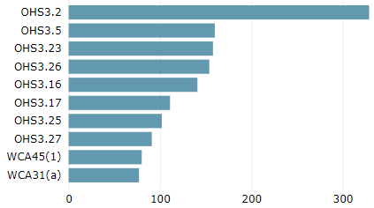
Risk Management Basics YTD-May 2022
2022
Focus on hazard identification, controls, and control systems. Assisting employers & workers to manage risk in a workplace focusing on four basic steps: Understand the nature and level of risk in workplace. Implement appropriate measures. Communicate policies and protocols to all workers. Monitor measures regularly and update them as required.
Output Measures
YTD | Orders | Orders w/ potential high-risk violation | Warning letters | Citation warnings | Stop-use orders | Temporary cessation of work | Penalties imposed
 | 1,520 | 60 | 2 | 8 | 2 | 16 | 0
Top regulations cited
JH&SC - Findings
From the 2,573 Inspections, 773 employers were required to have a JH&SC in place
From the 773 employers who should have JH&SC in place, 77 (or 10.0%) of those did not meet the obligation and 152 (or 19.7%) did not conduct effective annual reviews
5
Notes:
Out of the 2,573 Inspections:
WCA31 = 77 (General requirement for an employer to establish a Joint Committee)
OHS3.26(2) = 152 (Evaluation of Joint Committees)
Total IR with WCA31 referenced = 773

Slide 6
Construction High Risk Strategy
Notes:
Vision – Safe and healthy workplaces.
Mission – Prevent workplace injury, illness, and death.
Prevention Field Services
Risk Analysis Unit
Consultation Education Services

Slide 7
2021-2023 Construction High Risk Strategy
Overview: 2021 – 2023 Strategy Focus
A review of the BIA claims and injury data has determine that construction sector has the following experience:
High injury rate (2.2all/General construction 3.9)
High critical mass (injuries)
High serious injury rate (0.3all/General construction 0.8)
High MSI rate (0.7all/General construction 1.08)
Unaligned risk opportunities
Notes:
The injury rate and serious injury rate in the industry subsectors in construction (comparison to a provincial injury rate of 2.2 and a serious injury rate of .3):
CU 7210 General Construction injury rate of 3.9 and serious injury rate of .79 (3-year average 2017 to 2019)
CU 7220 Heavy Construction injury rate of 2.8 and serious injury rate of .74 (3-year average 2017 to 2019)
CU 7230 Road Construction or Maintenance injury rate of 2.7 and serious injury rate of .49 (3-year average 2017 to 2019)

Slide 8
Construction HRS
Stakeholder Consultations
External stakeholder Bow-Tie analysis on preventing struck-by incidents
External Stakeholder Bow-Tie analysis on preventing HV contact
BC Construction Safety Alliance (BCCSA)
BCCSA Prime Contractor Technical Advisory Committee
Provincial Construction Advisory Team (PCAT)
Notes:
The external stakeholder Bow-Tie analysis was successful in that we identified confirmed industries lack of understanding of the requirement to apply the hierarchy of controls when preventing struck by incidents involving mobile equipment and vehicles. The industry practice is to start at administrative controls such as PPE.
Stakeholder presentations and webinars have been conducted specific to preventing struck-by incidents and ergonomics in construction. Good feedback has been received to date and a positive response to WSBCs focus on MSIP in construction. There is an understanding in the industry that overexertion and RSI drive the overall claims numbers and costs in the construction industry.
Key messages:
New resources available which are aligned with the four risk focus areas:
New fall protection plan template and guidance document-well received by external stakeholders
New webinar on Introduction to musculoskeletal injury prevention
Digital campaign “planning for 10” designed to increase awareness and knowledge of the HVLOA Regulation requirements and hierarchy of controls
New Hazard bulletin on increasing awareness on how to prevent struck-by incidents involving mobile equipment and vehicles
New publication currently being developed on how to conduct risk identification, risk assessment and apply the hierarchy of controls to prevent struck-by incidents involving mobile equipment and vehicles.
2. Presentations and webinars
Preventing Struck-by incidents involving mobile equipment and vehicles
Ergonomics in Construction
Feedback:
Ergonomics is a worthy focus in Construction and needs to continue
Significant gap in knowledge and understanding of ergonomic requirements in construction industry
Industry stakeholders are not understanding and applying hierarchy of controls to prevent struck-by incidents involving mobile equipment and vehicles
Poor planning and coordination of multi-employer construction sites and to ensure health and safety systems and processes are in place to ensure worker safety, especially, with the less sophisticated prime contractors.
Continue to see significant non-compliance with fall protection systems requirements, especially, in the single family residential wood frame industry.
Construction companies with fewer than 20 employees account for 78% of fatal falls
Workers over 54 and inexperienced workers had the highest risk of serious injury
Next steps
Continue with the four risk focus areas and augment the 2022 CHRS to increase focus on serious injury drivers. Look at building tactics that support our corporate and strategic goals.
Refine our approach to focus on specific CUs and employer targets that are experiencing high number of serious injury claims involving falls from elevation and struck-by mechanism of injury. Look at leading indicators to measure effective implementation of controls. Consider planned teams of officers to conduct strategy inspections that includes a quality component.

Slide 9
2021–2023 Construction High Risk Strategy
2022 Risk Management Basics
Risk focussed + OHS program implementation
Specific risk focus areas
Falls from elevation
Struck by
High voltage
Musculoskeletal
Tower cranes/ mobile equipment
Occupational Disease
Ladders
- Enhanced focus
Scaffolds
Work platforms
Fixed Structures
Mobile equipment
Limits of approach
Form 30M33 pilot
‘Plan for 10’
Overexertion and Repetitive Strain
Inspection
Supervision
Operation
Asbestos
Silica
Sensitizers
Lead
Welding
Hearing
Solar
Notes:
Year 1 - 2021
Focus on officer training
Environmental scan to determine employer understanding of Part 19
Risk Analysis conducted by WorkSafeBC with external stakeholders
Year 2 – 2022
- Increased officer presence
- Piloted enhanced 30M33 form
- Launched enhanced 30M33 form in June
- Launched the ‘Plan for 10’ Campaign’
Year 3 – 2023
- Continued enforcement
- Consultative outreach with primary stakeholders

Slide 10
Falls From Elevation
Notes:
Fall from Elevation
The problem: construction workers are working at height and falling without adequate and reliable controls in place which is resulting in serious injury and sometimes death. Driving the serious injury rate in construction.
The hazard:
Workers who carry out work activities on building exteriors may use a variety of methods to access specific work areas that introduce a hazard of falling. If no proper fall protection systems are in place workers can be exposed to the potential of falling from elevation which may result in serious injury or even death.
Roofs, ladders and scaffolds are the three major sources of fatal falls in construction.

Slide 11
Hazard/risk focus areas
Construction High Risk Strategy
Falls from Elevation
Problem: | Falls from elevation continue to drive the serious injury rate in the construction industry. Ladders are a primary cause for this because they are still the first tool chosen by many workers.
Action: | Continue to consult, educate and enforce as required while adding an additional focus on ladder use and whether it’s the ‘right tool for the job’
Outcome: | Greater awareness of hazard/risk assessment and a better understanding of the value in taking the time to choose the correct tool.
Ladders
- Enhanced Focus
Scaffolds
Work platforms
Fixed Structures
Notes:
1. Fall from Elevation
The risk of falls from elevation continues to drive the serious injury rate in the construction industry. General Construction ranks No. 1 in the top 10 subsectors for claims relating to all types of falls.
Often ladders are the first choice for workers and employers to carrying out work at elevation. When a worker works from a ladder and falls there is a fail to danger instead of fail to safe. In other words, if a worker falls from a ladder when working at elevation there are no control measures to prevent the risk of serious injury. Losing balance, slippery surface conditions, transitioning to ladder or work platform, unclipping life line are examples of causes that lead to the risk of falls from elevation in construction.
Ladders are a first choice tool…

Slide 12
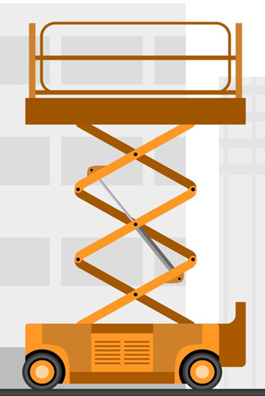
#1
Falls from elevation drives the no. 1 contributor to serious injury rate in the construction industry. From 2010-2020 the following circumstances applied.
Fixed structures, e.g. roofs
High risk hazards
Accessing an exterior building without the proper controls to prevent a fall
3 938
Claims for serious injury were submitted due to a fall from a height including…
Ladders
Workers
Scaffolds
124 days
OVER
54
Time off work a typical falls related claim required. Considerably longer than the weeks for all serious injury claims
INEXPERIECED WORKERS
Platforms
Had the highest risk of serious injury

Slide 13
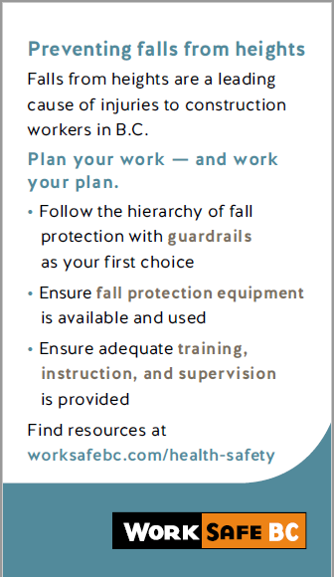
The Fall Protection Hierarchy What is it?
Notes:
Unless elsewhere provided for in the regulation an employer must ensure that a fall protection system is used when work is being done at a place where a fall of 3m (ten feet) or more exists or where a fall of less than 3m creates the risk of injury greater than if the worker was to fall 3m or more onto a flat surface. The employer must also follow the hierarchy and cannot choose a lower level of control unless it is justifiably impracticable.

Slide 14
2022 Enhanced Inspection Initiative Falls from Elevation Involving a Ladder
If work cannot be done from a ladder without hazard to a worker, a work platform must be provided
Risk Assessment checklist for ladder safety
Better understanding of the problem
Findings will guide our future strategy work

Slide 15
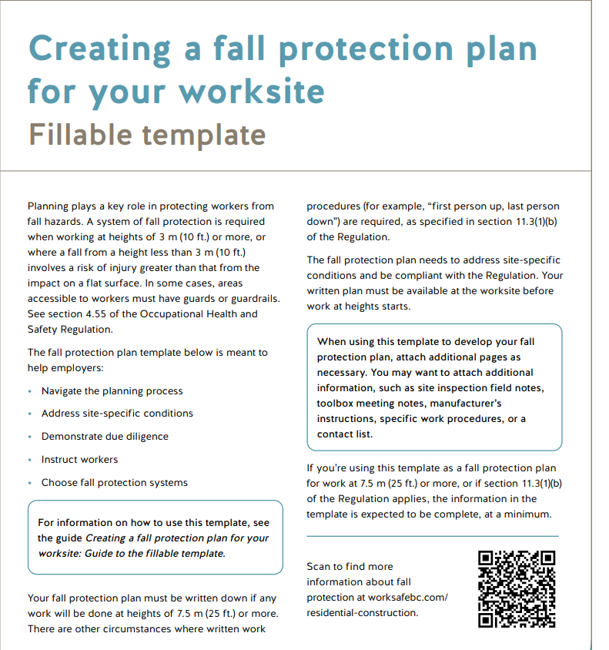
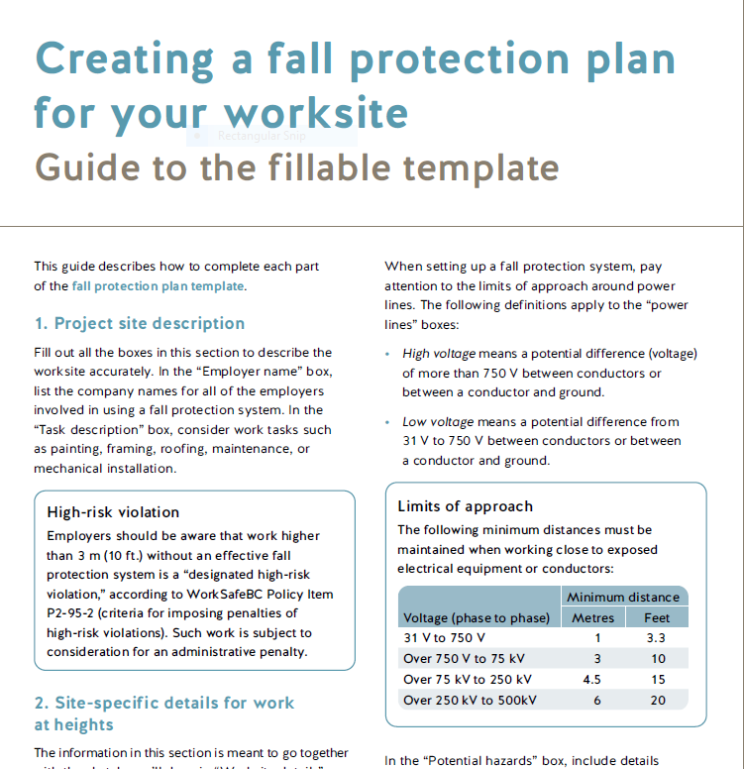
Fall Protection Resources
Notes:
WorkSafeBC has a number of resources to help workers and employers reduce the risk of MSIs.
WorksafeBC produces an Ergonomics E-news bi-annually – a great source of information to both help get started and enhance your MSIP efforts! You’ll find tips and strategies to identify and control MSI risks in the workplace
Also..the other resources we will send out following this webinar
[1]You’ll find this first booklet very helpful – most of the information we shared today is in there – it’s useful to guide you through the steps and provide all the materials to help you get started with educating workers
[2] The second booklet is for employers and JCs and lists more information to help identify, assess and effectively control MSIs risk (with 6 pages of control options)
[3] How to make the computer station fit you is an excellent resource also on our website and also helpful for home office settings
[4] the Blue man video is a good refresher on how to eliminate and reduce risks related to lifting

Slide 16
Struck-by’s
Notes:
550 back-over incidents from 2001-2018
16 fatalities
Driving the serious injury rate in construction. Looking to focus on workers who work in proximity to mobile equipment that is in motion and where the equipment is moving from one location to another. RAU currently has a risk assessment project where we will be using their risk analysis to guide us in our focus for next year. BIA review of the injury data identifies includes a focus on struck-by injuries relating to equipment and machinery in their recommendation for our CHRS.

Slide 17
Hazard/risk focus areas
Construction High Risk Strategy
Struck-By
Problem: | Struck-by injuries continue to drive the serious injury rate in construction and currently surpasses falls from elevation in the number of injury claims.
Action: | We will be consulting and educating employers on the importance of planning work around mobile equipment with the support of the newly developed resource. Corrective action will be taken in situations that require it.
Outcome: | A reduction in serious injuries or fatalities involving mobile equipment on construction work sites
Mobile equipment
Notes:
Raise awareness of the dangers caused by mobile equipment operated in proximity to workers in the construction workplace
Develop tools for industry to assess the risk and identify hierarchy of controls
2. Struck-by
Struck-by injuries continue to drive the serious injury rate in construction and currently surpasses falls from elevation in the number of injury claims.
WorkSafeBC injury statistics have identified 550 back-over incidents from 2001 to 2018. Among these incidents, 16 workers died when they were pinned, struck or rolled over by the mobile equipment or vehicles while they were reversing. The hazard involves workers working in proximity to mobile equipment while it is in motion and when effective control measures have not been implemented by applying the hierarchy of controls. There are multiple contributing factors that lead to serious struck-by injuries, such as, dynamic environment, congested work areas where workers are carrying out work activities that overlap with mobile equipment, multiple employers, types of mobile equipment, etc. Some of the most common contributing causes to struck-by incidents are work tasks being performed in proximity to mobile equipment, warning signals that are not available or ineffective and large vehicle blind spots.
We have a new information bulletin on reducing the risk of workers being struck-by vehicles or mobile equipment:
Reducing the risk of workers being struck by vehicles or mobile equipment | WorkSafeBC
We also are working on the final edits of a new employer resource guide and template on assessing the hazards relating to struck by incidents and pedestrian workers and identifying effective controls. We hope to have this guide and template published by the end of Q1 2022.

Slide 18
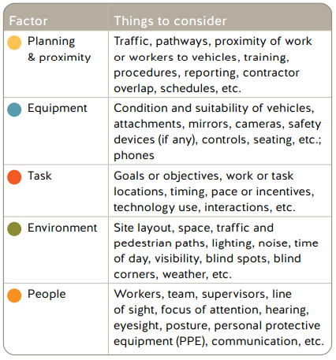
Preventing Struck-Bys
Notes:
WorkSafeBC Prevention Officers will be conducting workplace inspections that will look at how employers and Prime Contractors are effectively preventing struck-by injuries. These inspections will take a risk based approach that will look at employer’s and worker’s knowledge of the hazards and risks. In addition, officers will be assessing employer’s risk assessments and controls.
The objectives of the struck-by risk focus:
1. Increase awareness, understanding and knowledge in the construction industry on how to effectively prevent struck-by injuries relating to workers carrying out work tasks in proximity to mobile equipment.
2. Ensure a consistent level of knowledge amongst WSBC Prevention Officers – officers will be reviewing employer’s risk assessments and the employer’s application of the hierarchy of controls to reduce this risk. Assisting employers and workers on identifying the hazards and providing education and consultation will be a large focus this year to ensure employers and workers understand the risk and are implementing effective controls.
3. We will further analyze the risk data and gather input from employers and workers in the construction industry on better understanding the problem relating to struck-by injuries.
We know that working in proximity to ME often results from the dynamic work environment, congested sites where there is a high prevalence of workers overlapping with ME, and multiple contractors on site. The types of tasks being performed by vehicle operators and pedestrians, workers as well as the vehicle including availability of warning signals, blind spots, etc., and human performance factors such as lines of sight, focus of attention, etc. need to be assessed.

Slide 19
Hierarchy of Controls
Notes:
Most listening may already be familiar with The Hierarchy of Controls
The most effective controls are at the top and include the best protections for all workers then it moves to less effective controls down to PPE being the least effective and requiring the highest level of supervision. The six categories are shown:
Explain and point to examples on the alert in chat
Elimination: Removing the hazard entirely or separate workers from a hazard
Substitution: Replacing a severe hazard with a less severe one
Engineering Controls: Replacing equipment or changing the work environment, using technology and/or equipment to protect workers
Awareness: may include signs, information, alarms, etc. to bring attention to a hazard
Administrative Controls: could include Developing formal procedures and processes. Also educating workers on the hazards
Personal Protective Equipment: Equipping workers with clothing, lapel badges

Slide 20
Start at the Top
Separate pedestrian and mobile equipment
Plan and organize every project, yard, parking lot, so that vehicles and workers are kept separate.
Develop and provide traffic control plans.
Create vehicle-only areas.
Eliminate or limit the need to reverse.
Design and physically demarcate dedicated pedestrian routes.
Designate loading, unloading, traffic areas to prevent worker and vehicle interactions.
Notes:
Separating foot and mobile equipment traffic is not only extremely important but required by Regulation 16.43
The biggest thing you can do to help reduce struck-by incidents is finding ways to make sure that vehicles are never driving in areas where people may be walking.
Pause
When it is not possible, limiting the locations where both people and vehicles are as much as possible can be helpful.

Slide 21
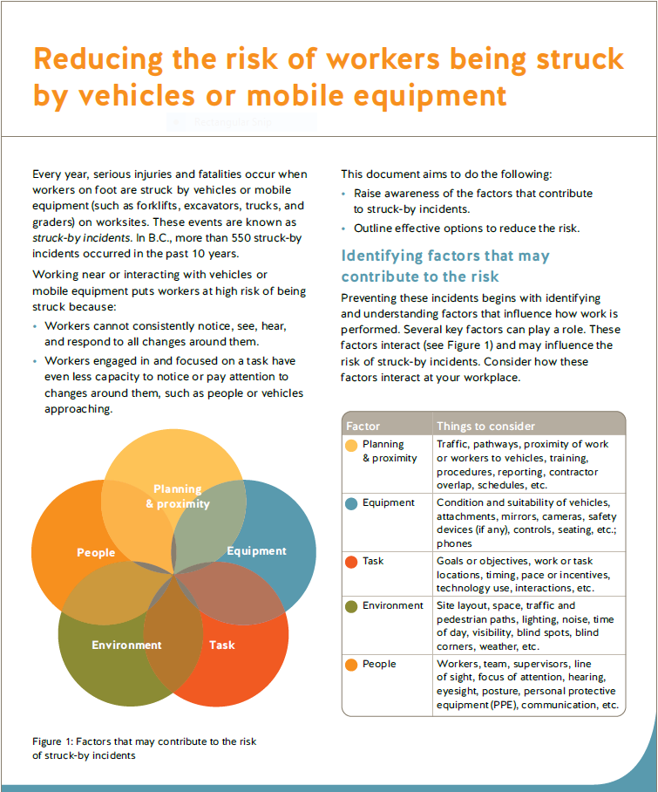
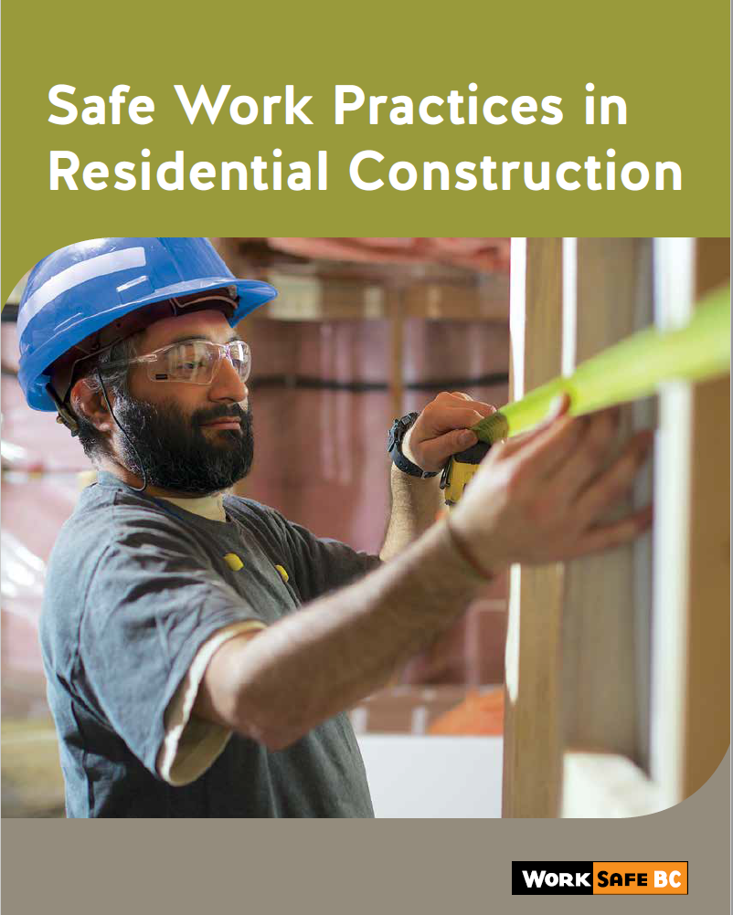
Struck By Resources
Notes:
WorkSafeBC has a number of resources to help workers and employers reduce the risk of MSIs.
WorksafeBC produces an Ergonomics E-news bi-annually – a great source of information to both help get started and enhance your MSIP efforts! You’ll find tips and strategies to identify and control MSI risks in the workplace
Also..the other resources we will send out following this webinar
[1]You’ll find this first booklet very helpful – most of the information we shared today is in there – it’s useful to guide you through the steps and provide all the materials to help you get started with educating workers
[2] The second booklet is for employers and JCs and lists more information to help identify, assess and effectively control MSIs risk (with 6 pages of control options)
[3] How to make the computer station fit you is an excellent resource also on our website and also helpful for home office settings
[4] the Blue man video is a good refresher on how to eliminate and reduce risks related to lifting

Slide 22
High Voltage
Notes:
Catastrophic risk and risk of serious injury is high
Part of the 2018-2020 CHRS where we started our focus this year in 2020 with phase 1. We will continue our focus going into 2021 with phase 2 of our focus which will be mainly be education and consultation and outreach with the support of CES.

Slide 23
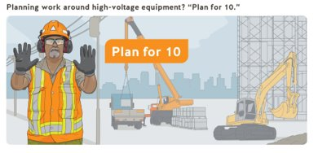
Hazard/risk focus areas
Construction High Risk Strategy
High Voltage
Problem: | Work around high voltage conductors poses a significant risk to workers in the event that contact is made.
Action: | Conduct a risk control analysis with internal and external stakeholders. Launch an awareness campaign to promote consistency in planning/carrying out work and take corrective action in situations where the controls are not adequate
Outcome: | A more consistent understanding across all of the stakeholders engaged in working around high voltage conductors
Limits of approach
Form 30M33 pilot
‘Plan for 10’
Notes:
Working close to High Voltage
Exposure to high voltage power lines is an identified high risk work activity, and the hierarchy of controls are meant to provide the highest level of protection to workers that is practicable for the worksite.
There are many stakeholders involved in the selection of a control method, and some controls in the hierarchy may not be available on projects where time and costs have not been considered at the planning stages. Involving all relevant stakeholders in the early stages of the project is critical to allowing the appropriate control to be selected in the hierarchy of controls.
We completed an external stakeholder bowtie analysis last fall to better understand the risk and how effective controls can be implemented.
We kicked off a media campaign last fall “Plan for Ten” to increase the knowledge and awareness of the risk of high voltage and how to plan work around high-voltage to prevent worker and equipment contact with high voltage. This campaign organized WSBC’s resources in one location to assist employers and worker in their planning and applying the hierarchy of controls.

Slide 24
Key’s of Part 19 - Summarized
OHS19.24 – The high voltage hazard must be identified and communicated to workers and every effort must be made to maintain the limits of approach
OHS19.25 – If the limits of approach can’t be maintained the level of control must be identified and the Board must be notified by means of a completed 30M33 assurance in writing.
OHS19.26 – If the limits of approach cannot be maintained and an assurance in writing is not practicable then the Board must be notified and acceptable procedures approved.
Notes:
30M33 KEYS
Acts as a record of discussion
Job Task
Hierarchy more clearly specified
Clearly defined scope of work

Slide 25
Types of low and high voltage Typical distribution utility pole
Notes:
High voltage means a potential difference (voltage) of more than 750 volts between conductors or between a conductor and ground
Low voltage means 31-750 volts
Generally if they have transforms (think garbage cans) they are going to be high voltage
19.24 - PLANNING
Ask yourself:
Is there powerlines or high voltage equipment at the site?
Could they hit the high voltage?
What has been done to mitigate the work from entering the limits of approach?
19.24 is about planning and making the decision – are you going to enter the limit of approach? If so, what’s the plan.
Planning, coordination and communication of the work.
Identifying the hazards, and associated risks. Controls or plans.
Orientation of all workers.
Communications with other trades - i.e., Concrete pump trucks coming on line.
Incident response plan. What happens when a contact is made?
Find out the voltage of the equipment.
Contact the utility to identify and verify.
19.24 the project is staying out of the limits of approach.
What does it mean to an employer:
Find out the voltage of the equipment.
Contact the utility to identify and verify.
Could be discussion only about 30M33 could decide if they start looking at alternatives or how work can be done outside the limits.
Opportunity to educate the contractor on the benefits of staying in 19.24 or what it means to move to 19.25
SWP – Employer needs to have arrangements made to maintain the limits., signage, training, delineators.
19.25
19.26
Overhead high-voltage conductors (lines) are usually installed at the top of utility poles. IF there is more than one conductor, they are usually placed side by side on a crossarm (this is three phase). If there is a transformer on the pole, the high voltage conductors are mounted above it. Employers are responsible for accurately determining the voltage of all conductors on the pole or in the work area.
Insulator – materials that don’t conduct electricity and used where a live element contacts a non-insulated surface..what connects the high voltage lines to the poles
Drop out fuse – protects the transformer from surges or overloads
-The arm of the fuse will drop down if it’s blown – visual sign to the linesman – serious event has occurred.
If you see the arm hanging down, phone the hydro provider.
Do NOT assume that the power is off because the fuse is blown.
Transformer – decreases the voltage from the primaries to low voltage,
Service drop carry the low voltage to the building..home or business

Slide 26
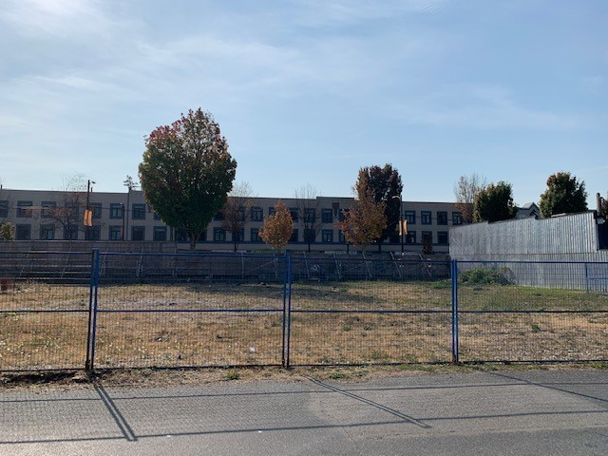
Notes:
PLANNING IS KEY
Powerlines actual design and layout (not often is it straight up and down)
Where are deliveries, pump trucks, scaffolding, storage of equipment etc. going to be?
Cost is always more after incident
- re-certification of crane
- replace lines
- equipment fuses and circuitry
Ask questions and reach out early.
Can you schedule building and burying of lines?
Can you move the lines?
Can you start on the south side of the building?
Hierarchy
Eliminate – Bury
De-energize and re-route
Guarding – Visual indicator i.e., flagline and sheath

Slide 27
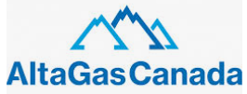
Identify utility/electrical owners
It’s the Employer’s responsibility to identify the power authority
Notes:
Ask the learners if there is anyone from up North has had an experience working with the northern authorities what was it like? Did they follow a 30M33 process?
BC Hydro:
It is the main electricity distributor, serving 1.8 million customers with the exception of the City of New Westminster and the Kootenay region, directly provides electric service to 213,000 customers and supplies municipally owned utilities in the same area
FortisBC
Serves approximately over 176,000 customers directly in communities throughout south central British Columbia, including Kelowna, Osoyoos, Trail, Castlegar, Princeton and Rossland and approximately 48,500 customers through the wholesale supply of power to municipal distributors in the communities of Summerland, Penticton, Grand Forks, and Nelson. The company owns and operates approximately 7,200 kilometres of transmission and distribution power lines.
City of New Westminster has a power division as part of the city workings.
Terrace:
Rio Tinto – Kemano to Kitmat
Altagas – feeds into the BC Hydro North west transmission line
Brucejack Mine –private powerlines (regional power corp)
Run of the river projects feeds into the main power grid
Columbia Power Corp – Undertakes hydro-electricity projects in the Columba River Region (Brilliant Dam; Arrow Lake Generating Station)
Nelson Hydro – City of Nelson owned supplies City of Nelson. Covers from Nelson Hydro Power Plan on Kootneay River to the west, Blewett, Taghum, Sproule and Grohman Creek, Hwy 6 south towards Salmo to Perrier Road North and east along Kooteny lake to Harrop – Procter, Balfour, Queens Bay and terminating at Coffee Creek north of Queens Bay along Kootenay lake
Synex International Inc. Owns Kyuquot Power Ltd – powers from Zeballos to fair harbor.

Slide 28
Hierarchy of Controls
Elimination/Substitute - Electrical equipment and conductors must be displaced or rerouted if practicable.
Engineering - Electrical equipment must be isolated and grounded if practicable
Administration - Electrical equipment will be visually identified and guarded
If the options above are not practicable and the limits of approach can not be maintained, per Table 19-1A and they are going to enter or potentially enter the limits of approach - ASSURANCE IN WRITING
Notes:
Hierarchy
Eliminate – Bury
De-energize and re-route
Guarding – Visual indicator i.e., flagline and sheath
The selection above depends on what is practicable, the circumstances of each workplace, and is a matter of assessment and judgment. Employers are expected to identify the potential risk and do everything that is reasonably practicable to prevent contact with the high voltage electrical equipment. This includes making a risk-based decision that includes the location of the high voltage electrical equipment, duration of the job, number of workers exposed, type and amount of equipment being used, collision avoidance device(s) installed on equipment, and worker training.
If the limits of approach can not be maintained with Table 19-1A and they are going to enter or potentially enter the limits of approach.

Slide 29
BC Hydro and Fortis 30M33 process
30M33 Request
Initial Site Meeting
Encroachment likely
Yes
No
Controls practicable?
Discussion only
Yes
No
Control option selected
Precautions Required
Design and cost estimate
Control option installed
Site meeting to review
BCH rep submits 30M33
Follow up meeting
Notes:
Explain guideline G19.25
The "assurance in writing" form is generally referred to as a WorkSafeBC 30M33 form. 30M33 form is provided to and used by all power system owners in B.C. It is currently the only assurance in writing form that is acceptable to WorkSafeBC.
Generally, the 30M33 form is needed to obtain information about high voltage electrical equipment and used when the requirements of section 19.25 of the Regulation apply to the work being performed. Generally the 30M33 form does not need to be used when the work is being performed in compliance with the Regulation sections 19.26, 19.27, 19.28, or 19.29.

Slide 30
Plan for ‘10’
Notes:
Plan for Ten is about ensuring all parties involved in work around or to high voltage equipment have the same understanding about the minimum regulatory requirements and their ability or responsibility to make decisions that will have positive outcomes to the types of hazards and levels of risk workers are exposed to…
Know the voltage
Employers and workers who need to work near electrical lines are required to know the voltage carried in those lines. You can confirm this by contacting the owner of the utility, and then the limit of approach (usually 10 feet or 3 metres) can be determined. The limit of approach or minimum safe distance applies to the worker, materials, or equipment, whichever is closest to the high-voltage line.
If the minimum distance in the table above cannot be maintained, then an assurance in writing must be obtained using Assurance of compliance with Occupational Health and Safety Regulation, part 19 (form 30M33).
Everyone has a role to play to “Plan for 10”
When starting a new construction project, owners, developers, architects, and engineers play a critical role in planning for the long-term health and safety of all workers involved in the project. Equally as important, employers, contractors, and workers need to understand their responsibilities when working near high-voltage electrical equipment and conductors.

Slide 31
Everyone has a role to play to “Plan for 10”
Effectively planning to work around high voltage electricity has to start at the conception of the project not when the first bucket of dirt is moved. Everyone has a role including:
- Owner, developers, architects and engineers
- Municipalities
- Prime Contractors
- Employers
- Workers
Notes:
All the parties need to be involved to be able to create a full plan.
Missing people results in missing information or sign off.
Owner: - Controls the budget and must be present during all conversations where the employer would be responsible for ensuring their systems and procedures are adequate and effective to allow work activities to occur in in close proximity to the energized high voltage power lines.
City: Permitting process for the work; drawings and plans get submitted for approval
Power Authority: Does the work, provide alternatives for elimination and or rerouting etc. This work is generally done by a electrical designer.
Prime Contractor: Coordinates of the on site activities.
Electrical Engineer: Generally a consultant hired by the owner. Will create the electrical design for the project.
Note: May have several primes during the different phases of construction.
Must meet the intent of section 24 prior to considered as the Prime Contractor.
First meeting most likely with prime contractor/owner.
Ask questions about options, burry lines have the discussion about the workers, tools, substitutions, eliminations, controls, PPE, then 30M33
This is the chance to keep it out of the 30M33 process.
Will eliminate the hazards during construction and after for maintenance
Opportunity to sell the benefits of the re-design. It’s really important to get there early. Owner is often fearful of the cost factor. Don’t see the implication on production. Can’t work within the safe limits. Should have been addressed earlier.
Helps to lay the framework for the 2020 strategy.

Slide 32
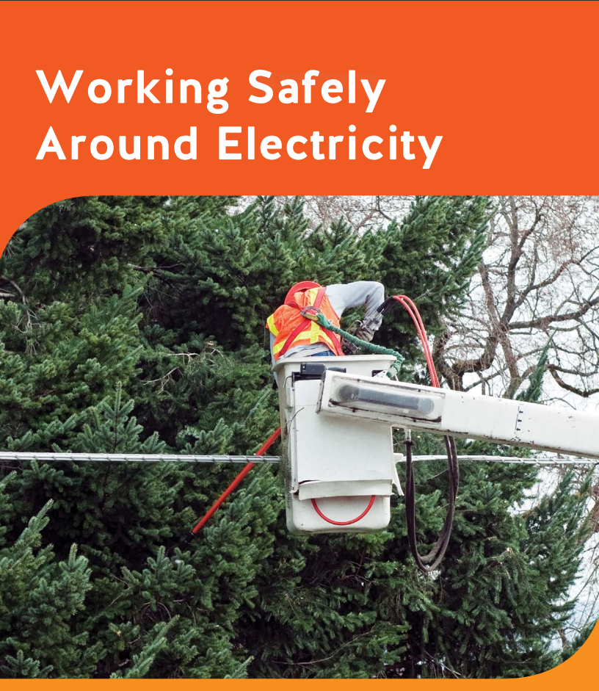
High Voltage Resources
Planning work around high-voltage equipment? “Plan for 10” – WorkSafeBC
Notes:
KEYS
Acts as a record of discussion
Job Task
Hierarchy more clearly specified
Clearly defined scope of work
Power utility system owners and contractors/employers must complete Form 30M33 together before any workers work within the “limits of approach” (usually 3 meters or 10 feet) of high-voltage equipment or conductors. A copy of the form should then be submitted to WorkSafeBC. This provides us with assurance in writing that there are appropriate safeguards in place to protect workers from the risks of working near high-voltage electricity.
Form 30M33 will continue to help our prevention team connect with contractors/employers. When we receive a Form 30M33, our prevention officers may reach out to ensure the steps being taken are adequate to protect workers against exposure to high-voltage electricity.

Slide 33
Preventing Musculoskeletal Injuries
Notes:
MSI rate in General construction is 1.08 (average of 3-years 2017 -2019) compared to the provincial MSI injury rate of .7
MSI rate in Heavy construction is .67 (average of 3–years 2017-2019)

Slide 34
Hazard/risk focus areas
Construction High Risk Strategy
MSI/RSI
Problem: | Overexertion and repetitive strain injury (RSI) are the main accident types driving the number MSI claims in the construction industry.
Action: | There will be a significant focus on hazard/risk identification through consultation and education this includes providing and reviewing resources.
Outcome: | Greater awareness and enforcement where required will help to reduce the likelihood and frequency of MSI/RSI injuries.
Overexertion and Repetitive Strain
Notes:
4. MSI
General Construction is ranked No. 3 in the top subsectors for MSI injury and is ranked No 2 for severe MSI claims, specifically, the Long Recovery Sprains and Strains (LRSS). Overexertion and repetitive strain injury (RSI) are the main accident types driving the number MSI claims in the construction industry. We know manual handling hazards affect every construction trade. For example, glazers and glazing contractors lift and carry awkward and heavy materials. Many trades lift, carry and place materials manually.
Officers will focus mainly on education and consultation this year with respect to this risk focus and will be providing employer with a resource package to assist them in reducing MSI injuries. Officer will review with employers and workers how they can incorporate the ergonomic requirements into their existing formal or informal health and safety program.
Ergonomics - WorkSafeBC
Flooring: Contact Stress Can Increase Risk of MSI | WorkSafeBC
Drywall Work: Overhead Reaching Can Increase Risk of MSI | WorkSafeBC

Slide 35
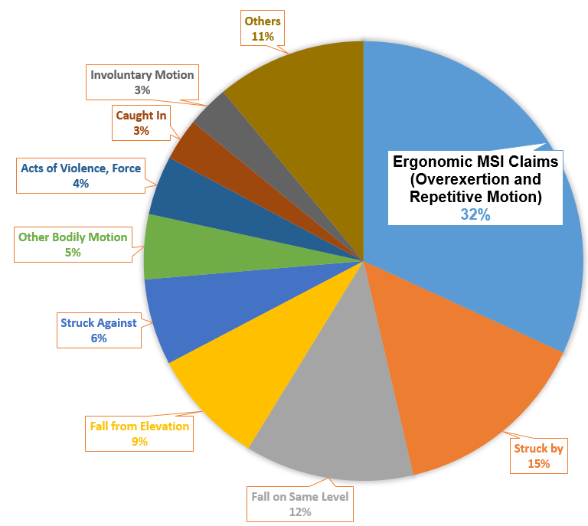
The Business case for Preventing MSIs
Notes:
Largest single source of lost-time costs
Long recovery and disabling health effects
Health and productivity
Innovation
MSI requirements
There are many reasons why preventing MSIs is important – it’s key for several reasons the top 5 being…
[1) MSIs are the most frequent and the most common lost-time, workplace injury in BC
[2] MSIs are approximately 32% of claims.
[3) MS injuries can become longstanding and sometimes have irreversible effects interfering with a healthy lifestyle.
[4) Taking proactive steps to prevent injuries benefits workers and employers at work and beyond the workplace. MSIP and ergonomics together helps keep workers healthy & safe at work, makes work easier and more efficient which translates to good morale, lower rates of turnover, fewer injuries – which benefits us all.
[5) Involving and consulting with the people who do the work, as well as maintenance, engineering in MSI prevention and ergonomics can generate excellent and innovative ways to get work done in a safe and efficient manner
[6) WSBC also has law that requires employers to eliminate or reduce the risk of MSIs on the job.
For all these reasons – MSIP – is vital and makes good sense (including dollars and sense) and the good news is MSIs are preventable.

Slide 36
Material Handing and Overexertion
Physical Demands (OHS4.49a)
Force
Repetition
Duration
Contributing Risk Factors (OHS4.49b-e)
Layout
Environment
Objects handled
Notes:
Where have changes been made to prevent or reduce back strains or shoulder injuries?
introducing a solution like a new tool or process
What jobs or tasks are the heaviest?
tasks where injuries have been reported
workers say its tough / awkward / heavy

Slide 37
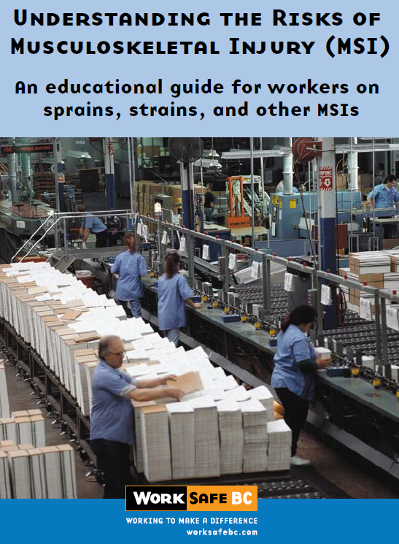
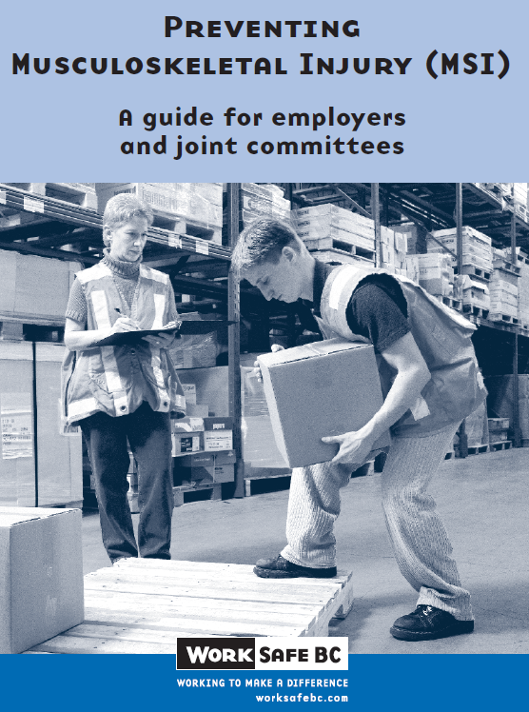
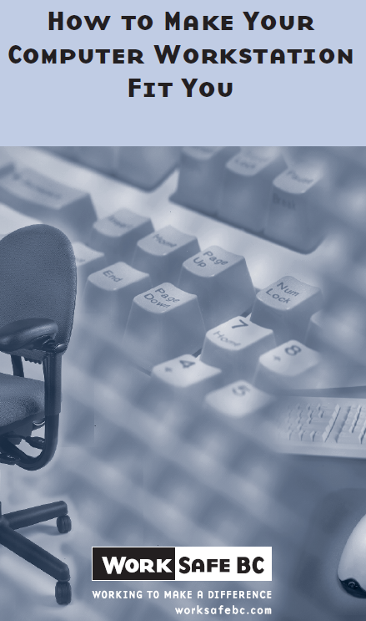
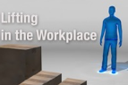
MSIP Resources
Ergonomics
Enews
Notes:
WorkSafeBC has a number of resources to help workers and employers reduce the risk of MSIs.
WorksafeBC produces an Ergonomics E-news bi-annually – a great source of information to both help get started and enhance your MSIP efforts! You’ll find tips and strategies to identify and control MSI risks in the workplace
Also..the other resources we will send out following this webinar
[1]You’ll find this first booklet very helpful – most of the information we shared today is in there – it’s useful to guide you through the steps and provide all the materials to help you get started with educating workers
[2] The second booklet is for employers and JCs and lists more information to help identify, assess and effectively control MSIs risk (with 6 pages of control options)
[3] How to make the computer station fit you is an excellent resource also on our website and also helpful for home office settings
[4] the Blue man video is a good refresher on how to eliminate and reduce risks related to lifting

Slide 38
Summary

Slide 39
Construction – Serious Injury Rate and Serious Injuries
Serious Injury Rate | 2015-2017 | 2018-2020 | % Change
Construction HRS | 0.83 | 0.73 | -12.0%
Struck By | 0.28 | 0.23 | -17.9%
Fall From Elevation | 0.25 | 0.19 | -24.0%
MSI | 0.04 | 0.04 | 0.0%
Serious Injury Claims Counts | 2015-2017 | 2018-2020 | Change
Construction HRS | 4,599 | 4,532 | -67
% of time-loss claims that are serious injuries | 22% | 20% | N/A
Struck By | 1,485 | 1,429 | -56
Fall From Elevation | 1,339 | 1,153 | -186
MSI | 206 | 232 | 26
Contact with Electricity | 43 | 27 | -16
Serious injury rate for Construction high risk strategy CUs has decreased by 12% between the 2 periods 2015-2017 and 2018-2020.
Notes:
Serious injury rate for Contact with Electricity has not been provided because it is not credible due to the low number of claims.

Slide 40
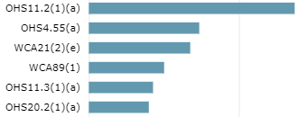
Construction – YE – 2021
2021 High Risk Strategy
Fall from elevation Struck-by Contact with electricity (education & consultation) Musculoskeletal injury (MSI)
Output measures
Top regulations cited
YTD | % op loc coverage | Orders | Orders w/ potential high-risk violation | Warning letters | Citation warnings | Stop-work orders | Temporary cessation of work | Penalties imposed
 | 7.3% | 8,536 | 1,200 | 241 | 70 | 237 | 422 | 160
Risk and Injury Impact
-8.3%
-12.0%
-4.8%
-15.5%
40
Notes:
Outreach activities this quarter
Presented to a youth employment program for the Métis Nation British Columbia focused on construction industry and falls from elevation, over-exertion and struck-bys
Presented to the Tradesman Association on falls from elevation and prime contractor responsibilities
Presented to Canadian Home Builders Association on falls from elevation and prime contractor responsibilities
Conducted external stakeholder bowtie analysis on high voltage contact
Fall from Elevation
The problem: construction workers are working at height and falling without adequate and reliable controls in place which is resulting in serious injury and sometimes death. Driving the serious injury rate in construction.
The hazard:
Workers who carry out work activities on building exteriors may use a variety of methods to access specific work areas that introduce a hazard of falling. If no proper fall protection systems are in place workers can be exposed to the potential of falling from elevation which may result in serious injury or even death.
Roofs, ladders and scaffolds are the three major sources of fatal falls in construction.
Struck-by
Driving the serious injury rate in construction. Looking to focus on workers who work in proximity to mobile equipment that is in motion and where the equipment is moving from one location to another. RAU currently has a risk assessment project where we will be using their risk analysis to guide us in our focus for next year. BIA review of the injury data identifies includes a focus on struck-by injuries relating to equipment and machinery in their recommendation for our CHRS.
Contact with Electricity
Catastrophic risk and risk of serious injury is high
Part of the 2018-2020 CHRS where we started our focus this year in 2020 with phase 1. We will continue our focus going into 2021 with phase 2 of our focus which will be mainly be education and consultation and outreach with the support of CES.
4. MSI
MSI rate in General construction is 1.08 (average of 3-years 2017 -2019) compared to the provincial MSI injury rate of .7
MSI rate in Heavy construction is .67 (average of 3–years 2017-2019)

Slide 41
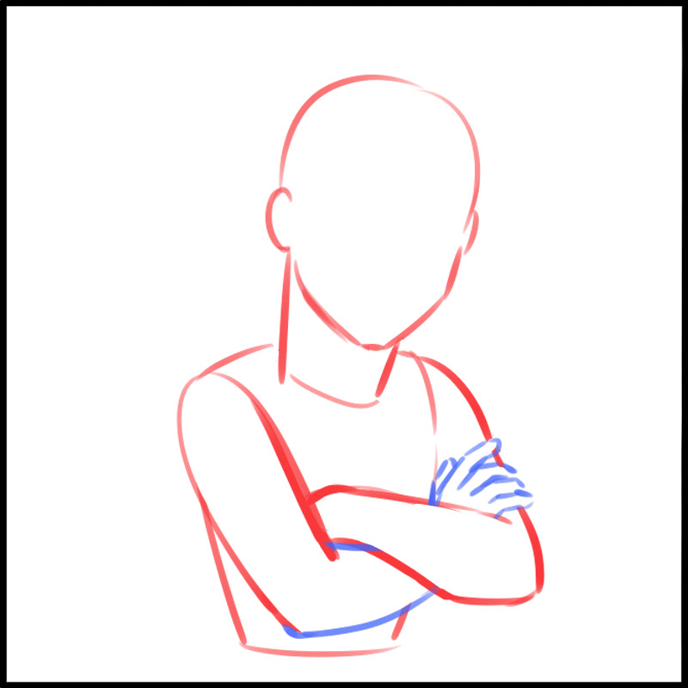
KEY THEMES
Planning
Hierarchy of controls
Notes:
The 2018 to 2020 Construction High Risk Strategy (CHRS) was developed due to address the following problem areas in the construction industry:
Inadequate planning and oversight by Prime Contractors on multi-employer worksites
Inadequate process or system in place for managing health and safety on multi-employer worksites by Prime Contractors
Inadequate supervision
Falls from elevation and struck-by mechanism of injury continuing to drive the serious injury rate
Contact with electricity continues to result in serious workplace injuries and death and has the potential for multiple worker serious injuries and fatals in a single incident

Slide 42
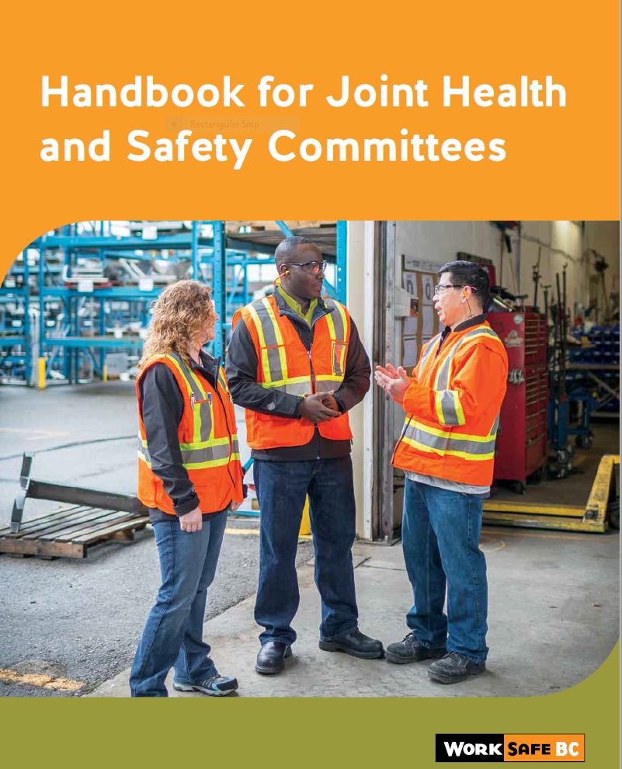
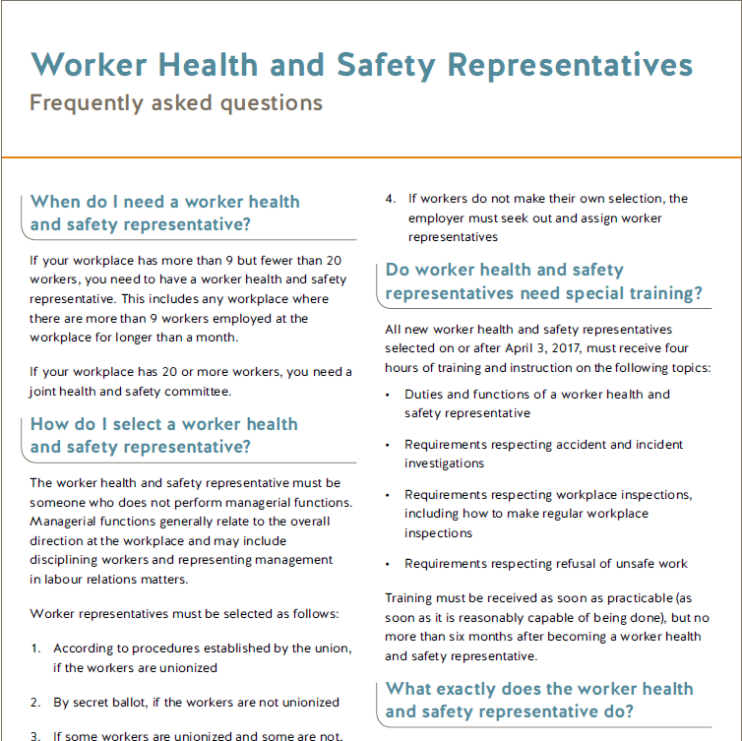
Thank you !
Steven.mah@worksafebc.com

